Slide 1





BUSINESS CLUB
INDIAN CASE CHALLENGE 2024
Rajobrata Dasgupta – Jadavpur University- 7439319042
(dasguptarajobrata@gmail.com)
Prathamesh Lokhande – IIM Mumbai –9175905505
(prathamesh.lokhande.2301122@iimmumbai.ac.in)
Prajwal Mandlik- IIM Mumbai –8149580913
(prajwal.mandlik.2301115@iimmumbai.ac.in)
Praveen Dharmak - IIM Mumbai – 7223832232
(praveen.dharmak.2301125@iimmumbai.ac.in)
Borno Banerjee– Jadavpur University - 7478054233
(bornob.ee.ug@jadavpuruniversity.in)
Vishal Agarwal - Jadavpur University- 6289101442
(vishalagarwal.2000v@gmail.com)
The Amigos

Slide 2
Executive Summary
Industry Overview
The AI industry is growing at a CAGR of 27.7%.
By 2030, AI could contribute up to 26% of some economies.
Revenue Model and Feasibility
Segmented revenue models for Customers, Developers and Enterprises with alternative revenue streams.
Financial and feasibility analysis of the revenue model.
Go-To-Market Strategy
Building up on pre-existing KPIs.
Community based targeting of Customers and Developers.
Oversaturation Issue
Introduction of a User Review Based System.
Weightage system to rate the Models.
AI Chip Industry & Challenges
The AI Semiconductor industry is growing at a CAGR of 18%.
AI chips would account for up to 20% of all Semiconductor demand.
Our Strategy
Phase 1 which encompass Target Identification.
Phase 2 which consists of Due Diligence and Assessment
Phase 3 which consist of Integration of startup in openAI and it’s talent retentatoin .
Viability
Feasibility Analysis of the various Phases undertaken.
Impact and Productivity of various metrics used.

Slide 3
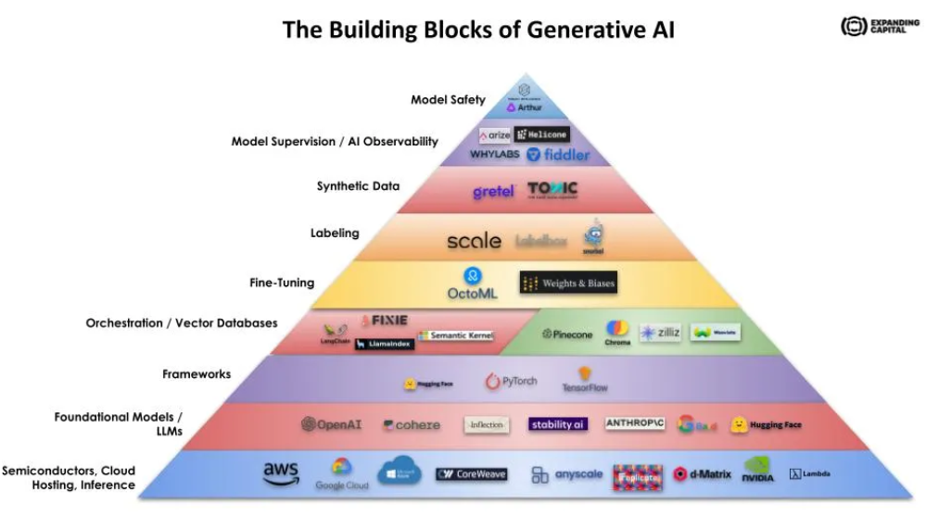

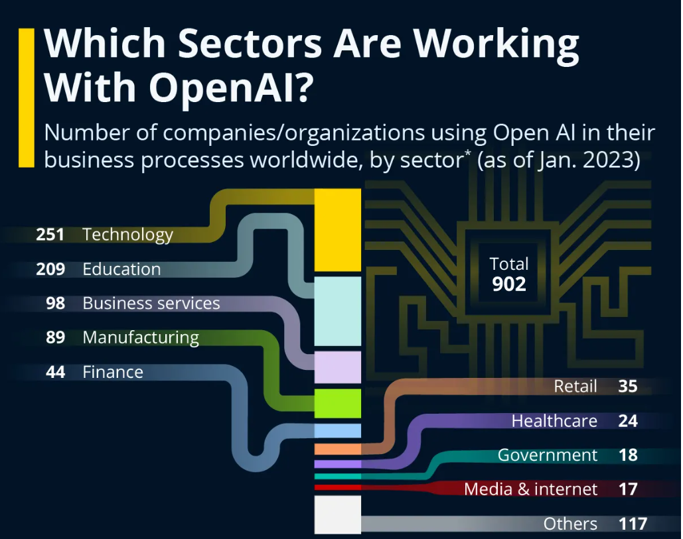
Industry Overview
Revenue Model and Feasibility
Go-To-Market Strategy
Oversaturation Issue
AI Chip Industry Overview
Our Strategy
Viability
Market size of AI industry (USD Billions)
OpenAI
CAGR 27.7%
4,000
3,000
2,000
1,000
0
OpenAI is an artificial intelligence research laboratory consisting of the for-profit OpenAI LP and its non-profit parent company, OpenAI Inc. It was founded in December 2015.
OpenAI valuation in 2024 is $100 billion which is approximately 4% of the total valuation and market share of the entire artificial intelligence industry of $500 billion.
Open AI’s revenue is predicted to grow 5x and reach $1 billion in 2024.
PwC's Global Artificial Intelligence Study estimates that AI could contribute up to $15.7 trillion to the global economy by 2030, representing over 26% of GDP growth for some local economies.
OpenAI Statistics
Total Visits
1.7B
Pages per Visit
5.34
Avg Visit Duration
00:05:21
Global Rank
20(+4)
Employees
501-1000
Bounce Rate
35.71%
Source – 1. https://www.demandsage.com/chatgpt-statistics/ 2. https://www.enterpriseappstoday.com/stats/openai-statistics.html
:

Slide 4




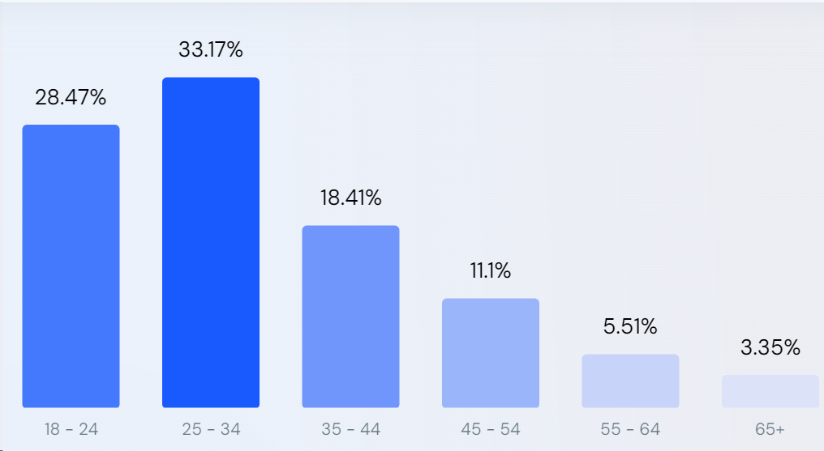
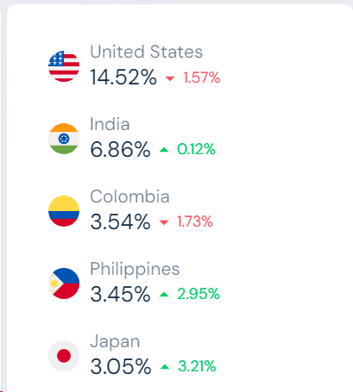


Industry Overview
Revenue Model
Feasibility
Go-To-Market Strategy
AI Chip Industry Overview
Our Strategy
Viability
Competitor | Strength -1 | Strength-2 | OpenAI Advantage
Anthropic | Safety: Prioritizes safe and unbiased responses, appealing to risk-averse users. | Factualness: Focuses on accurate information retrieval and knowledge integration. | Innovation: OpenAI pushes the boundaries in research with cutting-edge models like GPT-4.
Cohere | Business Utility: Offers practical "Command Models" for tasks like code generation, and data analysis. | Enterprise Focus: Tailored APIs and support cater to business needs and scalability. | :Versatility: OpenAI models handle a wider range of tasks beyond business functions.
Google AI | Computing Power: Access to vast Google Cloud resources for training large models. | Multimodal Expertise: Pioneers in combining text, image, for richer understanding. | Independent Focus: OpenAI is solely dedicated to AI research and while Google has broader goals
OpenAI Products
OpenAI Userbase
Age Distribution
Top Country
Gender Distribution
GPT-3
GPT-2
44.78%
ChatGPT
DALL-E
DALL-E
55.22%
Source - https://www.cbinsights.com/company/openai/alternatives-competitors

Slide 5



Industry Overview
Revenue Model and Feasibility
Go-To-Market Strategy
Oversaturation Issue
AI Chip Industry & Challenges
Our Strategy
Viability
Enterprise
INDIVIDUAL PLAN
Offer: Custom solutions for businesses (e.g., custom models, API access, dedicated support).
Target: Large companies, agencies, and research institutions.
Custom project contracts: Tailored solutions on client needs and budget.
API access fees: Tiered pricing based on API usage and data volume.
White-label licenses: Allow companies to integrate GPT-4 into their own products and services.
DESC | REGULAR | PRO | PREMIUM
GPTs per Day | 3 | Unlimited | Unlimited
Customization | Limited | Full | Full
plugins per month | 3 | Unlimited | Unlimited
word limit of Prompt | 200 | NO | NO
Ads
Cost | FREE | $18 | $20
Ads Revenue
GPT-specific advertising: ChatGPT could analyze the capabilities and functionalities of individual GPTs within the store.
Contextual in-GPT advertising: While GPTs generate content based on user prompts, ChatGPT could insert relevant ads within the generated text.
GPT-powered ad creation: Businesses could utilize ChatGPT to generate ad copy to the target audience of a particular GPT in the store.
DEVELOPER PLAN
DESC | REGULAR | PRO | PREMIUM
Submit GPTs per month | 1 | Unlimited | Unlimited
User Plan | Single | Single | 3
Priority Support |  | Anytime | Anytime
Revenue Share |  | Only on Gpts | Gpts as well as Ads
Extra Features |  | Admin Console | Dedicated Admin Console and Analytics Dashboard
Cost | FREE | $18 | $20
Insights into GPT's User-Driven Development
The total count of engaged users during the final month at OpenAI reached 200 million.1 million individuals (0.5% of users) form the core, driving Pro/Premium-powered development of GPT and its plugins. Another 0.5 million from Premium upgrades and 5 million using the free plan bring the total developer to 6.5 million, showcasing the significant user-diven development potential within the GPT ecosystem.

Slide 6


Industry Overview
Revenue Model
Feasibility
Go-To-Market Strategy
AI Chip Industry Overview
Our Strategy
Viability
REVENUE FROM CONSUMERS
REVENUE FROM DEVELOPERS
Consumer Segments
Estimated Consumers
Subscription Rate
Subscribed Customer
Estimated Revenue
Estimated Developers
Developer Segments
Estimated Revenue
Total No of Developer
= 4 millions . Each developers uploading 4 models each per year, the cost per upload is $30
Average Subscription price $30 . Total Revenue = $(30*15)*12 = $480 million .
.
High Income Country
(25% Customers )
Low Income Country
(75% Customers )
15 millions
Yearly Revenue (Median Price)= (20*15)*12 = 3600 millions = 3.6 billions
(50 millions Customers )
(40%)
(1.5 millions Pro and premium Combined )
Yearly Revenue (Median Price)= (20*7.5)*12 = 1800 millions = 1.8 billion
(150 millions Customers )
7.5 millions
(10%)
(free developers)
REVENUE FROM ADVERTISEMENTS
REVENUE FROM ENTERPRISE
Estimated ad revenue = Ad revenue per user * Number of users * Commission rate
Estimated ad revenue = $0.2 * 200 million users * 0.5
Estimated ad revenue = $20 million
Employees | Estimated Number of Companies | Estimated Number of Total Employees
10000 | 147 | 1470k
3000 | 235 | 705k
750 | 341 | 255750
50 | 442 | 22100
The total number of employees is 2,452,850. At a rate of $15 per month, the overall income amounts to $(2,452,850 * 15 * 12), which equals $441.5 million.
Expenditure and Operation Cost
Operating GPT-4 incurs a daily cost of $700,000, totaling $260 million annually.
Based on the data from comparable companies, we estimate the fixed costs to be around $200 million
Source - https://www.thinkimpact.com/openai-statistics/https://www.businessinsider.in/tech/news/chatgpt-could-cost-over-700000-per-day-to-operate-microsoft-is-reportedly-trying-to-make-it-cheaper-/articleshow/99637548.cmshttps://explodingtopics.com/blog/chatgpt-users

Slide 7






Industry Overview
Revenue Model and Feasibility
Go-To-Market Strategy
Oversaturation Issue
AI Chip Industry & Challenges
Our Strategy
Viability
ESTIMATED REVENUE
REVENUE FROM CONSUMERS + REVENUE FROM DEVELOPERS+ REVENUE FROM ENTERPRISE + REVENUE FROM ADVERTISEMENTS - EXPENDITURE = (3.6 + 1.8) BILLIONS + 480 MILLIONS + 441.5 MILLIONS + 20 MILLIONS – (260+200) MILLIONS = $5.88 Billions
Marketing Channel Distribution
Key Tactics
DEVELOPERS
Early access programs
Hackathons and challenges
Comprehensive documentation and tutorials
Competitive revenue sharing model
Investor Backing
Community Building
Data Privacy
First Movers Advantage
Forum and Q&A platforms
User-generated content contests
Regular updates and roadmap transparency
Performance
Clearly communicate data usage and privacy policies
Offer multiple deployment options
Transparent usage metrics
Clear user reviews and rating systems
Media Coverage
GENERAL USERS
Bounce Rate Analysis :
Track bounce rates on different store sections (landing pages, pricing, user dashboards).
Analyze drop-off points for both developers and users (e.g., complex registration, unclear value proposition).
Community Building
Focus on problem-solving
Intuitive user interface
Freemium model
Curated collections
Educational content and case studies
Calibrating Success
Massive User Base
Active developers and users
Number of uploaded GPTs and plugins
Revenue generated from purchases and subscriptions
User reviews and feedback

Slide 8


Industry Overview
Revenue Model and Feasibility
Go-To-Market Strategy
Oversaturation Issue
AI Chip Industry & Challenges
Our Strategy
Viability
The GPT builder could make it relatively easy for anyone to create and upload a GPT, even if it is low-quality or unoriginal. This could lead to a flood of low-quality GPTs in the store, making it difficult for users to find good ones. To overcome this problem of oversaturation we have the following recommendations
Formation of the Review Committee
Evaluating Model Engagement through User Interaction Analysis
Quantifying User Interaction
Explanation: To enhance the evaluation process, a user review mechanism will be implemented, incorporating a weighted scoring system to mitigate potential biases. The score will consider both star ratings and the number of users, ensuring credibility and reflecting broader consensus.
Explanation: A review committee from OpenAI side will examine all models prior to the publication of any specific plugin or model.
Explanation: OpenAI will conduct quarterly evaluations for each model by assessing the ratio of the total number of questions asked to the number of users who utilized that specific model.
Example: If a developer creates a model without plagiarism and follows the guidelines effectively, and initially pays $10 for uploading, they will receive an $8 refund. However, if plagiarism is detected, no refund will be issued.
For instance, if two models have the same number of users, let's say 100. However, for Model A, the total number of questions asked is 2000, and for Model B, it's 100. This indicates that, in the case of Model A, a user is asking 20 questions and receiving correct answers, leading to frequent use. Conversely, for Model B, users are not obtaining correct answers, resulting in less usage. Based on these evaluations, models with a rating below 2 will be removed.
A plugin with a 5-star rating from 3 users would receive a score of 5 (rating) + 1.5 (user base) = 6.5.
Conversely, a plugin with a 4-star rating from 5000 users would receive a score of 4 (rating) + 4.5 (user base) = 8.5, indicating its broader appeal and potential effectiveness
:
Limitations
Advantages
Advantages
additional cost for OpenAI in terms of paying their salaries
potential risk of bias among these reviewers towards specific groups of people.
This procedure will require a significant amount of time.
Objective Performance Evaluation: The method relies on quantitative data, providing an objective assessment of model performance.
User-Centric Focus
Resource Optimization
Continuous Improvement
Reduce bias by considering both rating and user base.
Promote authentic assessments by emphasizing widespread adoption.
Facilitate informed decision-making by providing comprehensive scores.

Slide 9
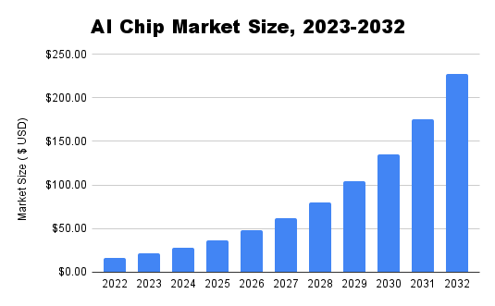
Industry Overview
Revenue Model
Feasibility
Go-To-Market Strategy
AI Chip Industry & Challenges
Our Strategy
Viability
If ChatGPT queries grew to a tenth the scale of Google Search, it’d require roughly $48.1 billion worth of GPU initially and about $16 billion worth of chips a year to keep operational ~ Bernstein Research
High-level expertise
Complexity of Specialized AI Chip Design
Resource Requirements
Strategic Decision-Making
Performance and Customization
Architectural innovation
Limitations of Existing GPUs
Specialized Needs
Balancing Act
Optimizing for Workloads
CHALLENGES
High costs
High Initial Investments
Funding Challenges for OpenAI
Exploring Partnerships
Financial Strategy
Time to market
Extended Timeframe for Market Entry
Investment in Time and Resources
Competition with Established Players
Long-Term Vision
AI-related semiconductors will see growth of about 18% annually over the next few years—5X greater than the rate for semiconductors used in non-AI applications
AI-related semiconductors could account for almost 20% of all demand which would translate into about $67 billion in revenue
Potential compatibility issues
Compatibility Concerns
Adoption Hurdles
Usability Impact
Strategic Considerations
Long development cycles
Extended Development Timeline
Patience Requirement
Adaptability to Challenges
Strategic Planning
Overall, demand for computing hardware will increase by about 10 to 15% through 2025
As ASICs enter the market, GPUs will likely become more customized to meet the demands of DL
Supply chain complexities
Global Chip Shortage Impact
Unpredictable Landscape
Importance of Reliable Partnerships
Ensuring Consistent Production
Physical design and manufacturing
Beyond Architecture Challenges
Intricacies in Physical Layout
Critical Aspects
Performance and Reliability
ASICs built into systems on chips will account for 70% of demand. FPGAs will represent about 20% of demand and will be used for applications that require significant customization

Slide 10
Industry Overview
Revenue Model
Feasibility
Go-To-Market Strategy
AI Chip Industry Overview
Acquisition Strategy
Viability
Phase 1: Target Identification
Market Analysis
Technological Alignment
Talent Pool
Innovation Pipeline
Cultural Fit
Growth Potential
Evaluate the startup's growth potential in the AI chip design industry.
Consider factors such as market trends, demand projections, and competitive positioning.
Define specific criteria for alignment with OpenAI's technological requirements.
Assess compatibility in terms of AI chip design, software integration, and overall technology stack.
Define criteria related to the startup's talent pool and expertise in AI chip design.
Evaluate the startup's team composition, skills, and experience.
Consider the startup's innovation pipeline and its alignment with OpenAI's future goals.
Assess the startup's commitment to continuous improvement and cutting-edge research.
Establish criteria for cultural fit, emphasizing shared values and collaborative work culture.
Evaluate the alignment of the startup's organizational values with OpenAI's mission.
Market Positioning
Analyze the startup's current market position and competitive landscape.
Identify potential market gaps that the startup can fill for OpenAI
Qualitative and quantitative analysis | Technological Alignment | Talent Pool | Innovation | Cultural Fit
Cerebras | AI chip design with wafer-scale architecture, 1.4 trillion transistors. | Talented team with expertise in AI chip design. | Demonstrates commitment to continuous improvement and research. | Collaborative and inclusive work culture.
Graphcore | IPU architecture optimized for deep learning and graph algorithms. | Specialized cores for efficient data flow and communication. | Focus on practical AI applications in various industries. | Emphasis on practical AI applications.
Weights | 0.4 | 0.2 | 0.3 | 0.1
Cerebras (rating out of 10) | 9 | 7 | 8 | 7
Graphcore(rating out of 10) | 7 | 9 | 8 | 8

Slide 11
Industry Overview
Revenue Model
Feasibility
Go-To-Market Strategy
AI Chip Industry Overview
Acquisition Strategy
Viability
Phase 2: Due Diligence and Assessment
Technical Evaluation
Financial Assessment
Technological Expertise
Patent Portfolio
Alignment with AI Requirements
Financial Health
Market Valuation
Assess the startup's technological capabilities and innovation in AI chip design.
Evaluate the uniqueness and competitiveness of the technology.
Examine the startup's patent portfolios related to AI chip design.
Ensure alignment with OpenAI's strategic interests and freedom to operate.
Evaluate how well the startup's technology aligns with OpenAI's specific AI requirements.
Ensure compatibility with existing and future AI projects.
Conduct a financial analysis of the startup's health, considering revenue, profit margins, and cash flow.
Assess financial stability and sustainability.
Determine the market valuation of the startup and its potential impact on the overall acquisition or partnership deal.
Consider the valuation in the context of OpenAI's budget and financial goals.
Cerebras or Graphcore -- An Example
Cerebras
Graphcore
Revenue: $ 169.7 Million, estimated to be in the single-digit million USD as of 2023.
Profit: operates at a significant loss due to high hardware development costs.
Cashflow: Backed by prominent investors like BlackRock and Fidelity
Revenue: Revenue declined 46% to $ 2.7 million
Profit: It reported pre-tax losses widened 11% to $204.6 million.
Cashflow: Generated positive operating cash flow of £8.5 million for FY22, indicating some financial stability.
Conclusion
Technology: Cerebras offers a unique and potentially game-changing architecture, while Graphcore provides a more mature and flexible solution.
Financial Viability: Graphcore appears more affordable and has near-term profitability potential, while Cerebras carries higher risks but could offer significant long-term value if successful.
Risk Tolerance: Cerebras involves greater financial and technological risk, while Graphcore presents a safer but potentially less impactful option.
Reliant on future funding rounds for sustainability, profitability uncertain due to high hardware costs.
Demonstrates early signs of financial stability with positive operating cash flow, but needs to turn a net profit for long-term sustainability.
Market Valuation:
Estimated valuation of $4 billion based on limited data and hardware focus.
Market Valuation: . Current market capitalization around $3 billion reflects lower but established revenue stream.

Slide 12
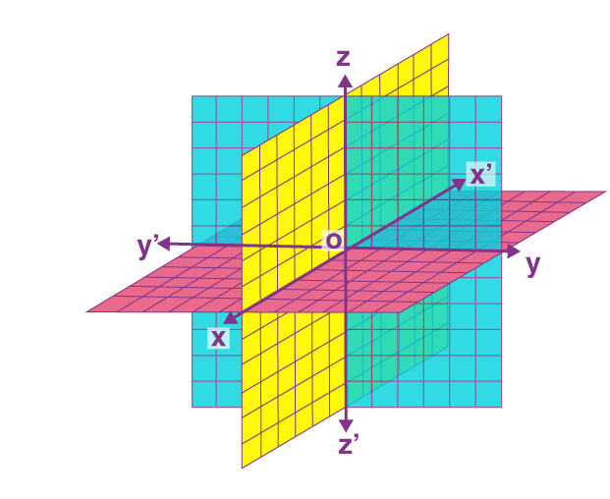



Industry Overview
Revenue Model
Feasibility
Go-To-Market Strategy
AI Chip Industry Overview
Acquisition Strategy
Viability
Phase 3: Integration and Talent Retention
Cultural Fit
Technological Integration
Talent Retention
Technological Integration
(High)
Assess the extent of alignment between OpenAI's culture and that of target company.
Prioritize the startup with a cultural fit that enhances collaboration.
Evaluate the compatibility and synergies of each startup's technology with OpenAI's systems.
Prioritize the startup with a technology that seamlessly integrates into OpenAI's infrastructure.
Identify the startup with a talent retention strategy that aligns with OpenAI's goals.
Prioritize the startup with key personnel critical for achieving OpenAI's objectives.
Cultural Fit
(High)
Talent Retention
(High)
Workshops
Employee Turnover Rate
Conduct Surveys
Evaluation Matrix
Audits
Outcomes & Benefits
Productivity
Best Practices
Improves Performance.
Increased Innovation,
Enhanced Efficiency.
Higher Satisfaction
Scale: 1(low) to 5(high)
Assign rating to Firms based on criteria using Data and analysis
Weight the criteria according to their relative importance and impact on the decision using fractions
KPIs
Quality
Engagement

Slide 13

Industry Overview
Revenue Model
Feasibility
Go-To-Market Strategy
AI Chip Industry Overview
Our Strategy
Viability
Feasibility Analysis
Category | Strength | Weaknesses
Phase 1 | Thorough target identification, cultural alignment, and market analysis | Complexity in technological alignment
Phase 2 | Comprehensive technical and financial assessment | Challenges in talent retention and potential financial challenges
Phase 3 | Focused cultural fit and technology integration | Challenges in talent retention and potential cultural misalignment
As Is Analysis | To Be Analysis
Dependency on Nvidia GPUs | Innovation Potential
Scaling Concerns | Speed to Market
Poor Performance Efficiency | Reduced Computation time
Chip Shortage | Hardware Software Synergy
Strategic Fit
ROI Expectations
Investment Capacity
Technology Integration
Market Readiness
Operational Synergy
Risk Analysis
Analysis
metric
Likelihood/ probability of occurrence
Risk Identification
Identify risk associated with proposed onboarding strategy based on technical, economical, Legal and operational factors
Risk Analysis
Define the certainty of identified risk
Prepare a matrix to analyze its impact and likelihood of occurrence
Implement solution
Identify solution and its synergies with OpenAI and the onboarded firm
 | Risks with less probability of occurrence and High impact | Risk with high probability of occurrence and High Impact
 | Risk with less probability of occurrence and less impact | Risk with High probability of occurnce and less impact
Impact created by identified risk

Slide 14
Industry Overview
Revenue Model
Feasibility
Go-To-Market Strategy
AI Chip Industry Overview
Our Strategy
Viability
Economic Synergies Cost savings due to operational efficiencies and economies of scale, reducing long-term production costs
Market Alignment Meets market demands for AI chips, positioning OpenAI to cater to evolving needs
Long Term Viability Ensures sustained growth and scalability
Strategic Goals Cements OpenAI's industry leadership, driving innovation in line with their AI advancement goals
Competitive Edge Access to exclusive technology, patents, enabling development of exceptional chips
Risk Management Diversifying mitigates dependency risks, ensuring a reliable supply chain

Slide 15
Benefits of this acquisition for Open AI and Startup
Allied Startegy – To de-risk Main Startegy
Open AI | Startup
Future-Proofing: Preparedness for evolving AI requirements. | Financial Support: Enhanced funding for R&D and product development
Customized Solutions: Tailored chip designs for optimized AI model performance | Resource Access: Utilization of OpenAI's expertise and infrastructure.
Strategic Control: Increased autonomy in chip design and strategy. | Market Validation: Credibility boost through association with OpenAI.
Accelerated Development: Faster chip development and deployment. | Stability and Growth: Potential long-term stability and scalability.
Market Leadership: Strengthened position in the AI tech landscape. | Knowledge Exchange: Learning opportunities and skill enrichment.
Diversified Suppliers: Reduced dependency on single suppliers, minimizing risks. | Scale Opportunities: Access to a larger customer base.
Licensing and Co-Development with Big Player | Equity Stakes in Multiple Startups
Risk Diversification Technological Validation | Diverse Technological Exposure Talent Retention through Equity
SOURCES
McKinsey Report: Artificial-intelligence hardware: New opportunities for semiconductor companies
14 Essential Steps For Effective And Efficient Onboarding (forbes.com)
Top 10 AI Chip Makers of 2024: In-depth Guide (aimultiple.com)
AI User Onboarding: 8 Ways To Use Artificial Intelligence to Drive Success (userpilot.com)
https://www.linkedin.com/pulse/generative-ai-business-model-how-openai-makes-money-kamalika-poddar/
https://community.openai.com/t/the-future-of-gpts-their-marketplace-monetization-joint-discussion-to-improve-planning/504689
Critical Steps To Follow For A Successful Tech Acquisition (forbes.com)

